Slide 1
IBEX 35
Stock Index Analysis

Slide 2
Introduction
Benchmark index of Bolsa de Madrid – Spain’s principal exchange
Administered and calculated by Sociedad de Bolsas
Comprises of the 35 most liquid Spanish stocks traded in the Madrid Stock Exchange General Index
Trading is provided by Mercado Español de Futuros Financieros (MEFF)
Both Sociedad de Bolsas and MEFF are owned by Bolsas y Mercados Españoles (BME) which runs the country’s security markets

Slide 3
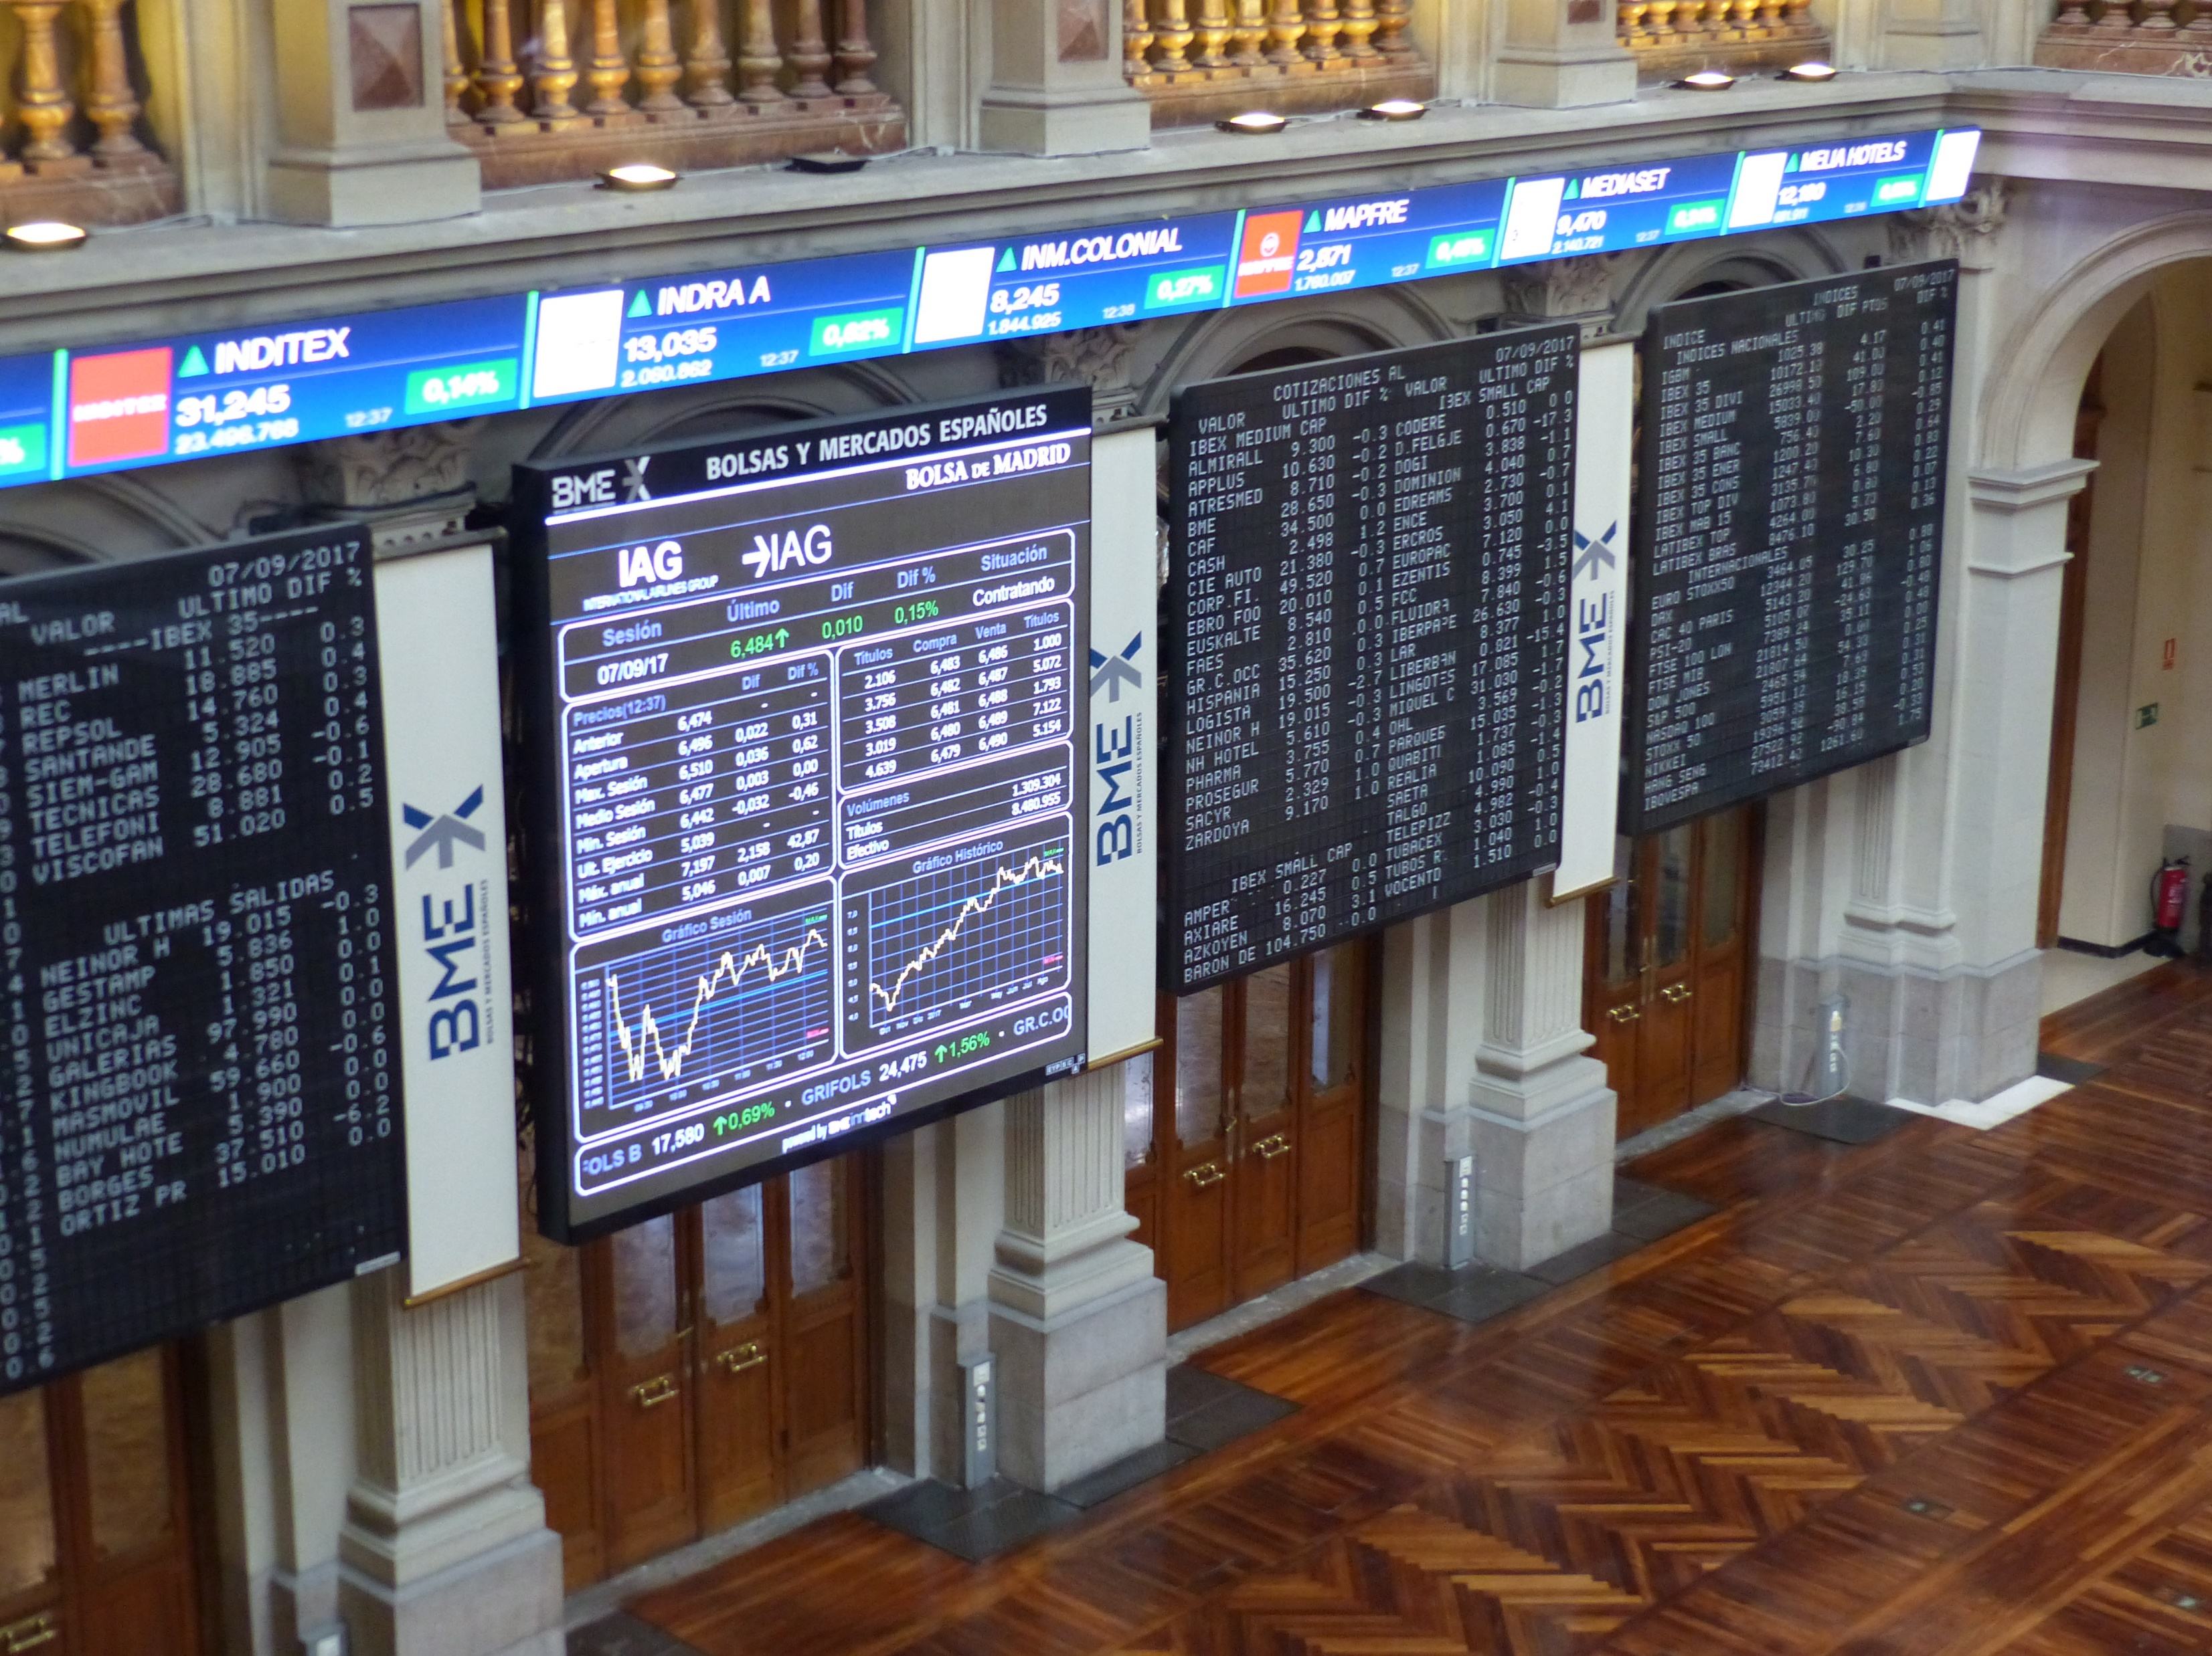
Interior of the Bolsas y Mercados Españoles building in Madrid

Slide 4
History
Inaugurated on January 14, 1992 (calculated values go back till 1989)
Many indices hold record highs during 1999-2000 (dot-com bubble)
However, IBEX 35 outperformed most of them between 2000-2007
Performed exceptionally in the 2000s driven by strong domestic economic growth
Consequently, IBEX 35 all-time maximum was on November 8, 2007

Slide 5
History in Dates
December 29, 1989 – Base value
January 14, 1992 – Inauguration
November 8, 2007 – All-time maximum
January 21, 2008 – Biggest single-day fall
January 24, 2008 – Biggest single-day rise

Slide 6
History in Numbers
Inaugural opening price – 2693.00
All-time maximum – 15945.70
Highest single-day rise – 6.95%
Largest single day fall – 7.5% (largest fall in Spanish equity market since 1987)

Slide 7
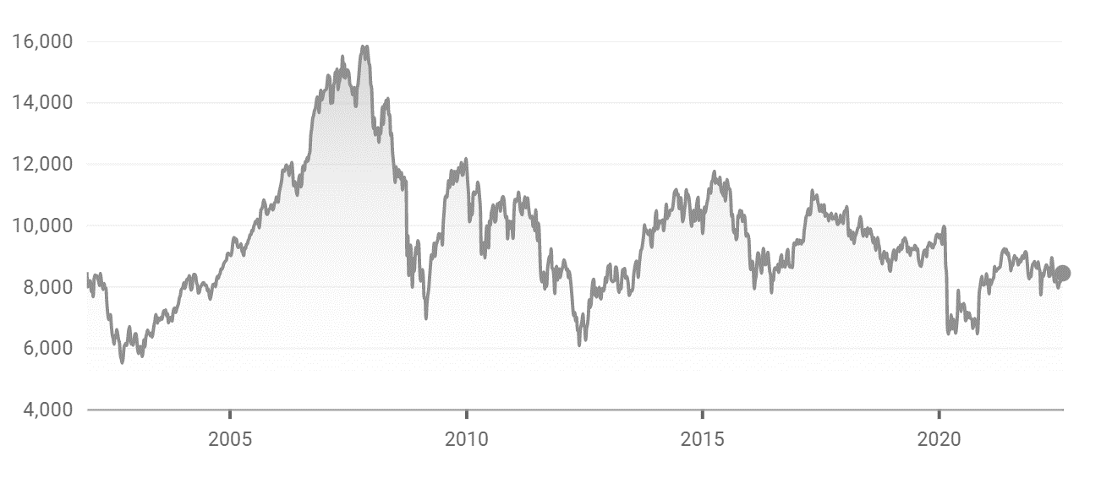
Performance Chart

Slide 8
Selection Committee
Composition is reviewed twice annually
Review conducted by the Technical Advisory Committee
Committee consists of:
Representatives of the Stock Exchange
Representatives of derivative markets
Academic experts
Financial experts

Slide 9
Selection Process
Any candidate stock must meet at least one of the following conditions:
Traded on at least a third of all trading days of the previous 6 months
Rank in the top 20 overall in market capitalization
In general, the 35 companies with the highest trading volume over the previous six months are chosen
Any changes made come into effect the next trading day after the third Friday of the rebalance month

Slide 10
Stock Weighting
IBEX 35 is a capitalization-weighted index – uses market capitalization for weighting of constituents
Market cap is multiplied by a free float factor:
Ranges from 0.1 to 1
Depends on fraction of freely floating (publicly available) shares of the stock
Companies with more than 50% freely floating shares are given a factor of 1
Unlike most European indices, there is no weighting cap for companies on IBEX 35

Slide 11
Foreign Investment
IBEX 35 displays above average foreign investment figures
Investors mainly include international funds from Norway, the United States, the United Kingdom and Qatar
Foreign investment growth:
1992 – 16%
2015 – 43%
Foreign investment figures 5% above EU average

Slide 12
Notable Constituents
ACS - Actividades de Construcción y Servicios – one of the leading construction companies in the world
Amadeus IT Group – major global travel & tourism service provider
Banco Santander (Santander Group) – 16th largest banking institution in the world
Grifols – largest producer of blood plasma-based pharmaceutical products in the world
Inditex – biggest fast fashion group in the world

Slide 13
Record Values
All time high:
Intraday:
9 November 2007 - 16,040.40
Closing:
8 November 2007 - 15,945.70
All time low:
Intraday:
5 October 1992 - 1861.90
Closing:
5 October 1992 – 1873.58

Slide 14
Annual Returns
Highest Profit – 1993
Change percentage: 54.20
Highest Loss – 2008
Change percentage: -39.43
Previous year
Change percentage: 7.93
Current month
Change percentage: 3.32

Slide 15
Similar Indices
IBEX Medium Cap: It is composed by the 20 listed Spanish companies with the largest capitalization after those included in the IBEX 35.
IBEX Small Cap: It is composed by the 30 listed Spanish companies with the largest capitalization after those included in the IBEX Medium Cap.
BME Growth: a sub-market of Bolsas y Mercados Españoles (BME) for smaller companies to float shares with a more flexible regulatory system than is applicable to the main market.

